Slide 1
COUNTERS

Slide 2
What is a Counter?
Counter is a device which can count any particular event on the basis of how many times the particular event(s) is occurred. In a digital logic system or computers, this counter can count and store the number of time any particular event or process have occurred, depending on a clock signal. Most common type of counter is sequential digital logic circuit with a single clock input and multiple outputs. The outputs represent binary or binary coded decimal numbers. Each clock pulse either increase the number or decrease the number.

Slide 3
Counters are classified into two broad categories according to the way they are clocked:
Asynchronous Counters
Synchornous Counters
Applications:
System clocks
Timers, delays
Watches, clocks, alarms
Memory addressing
Frequency division

Slide 4
Asynchronous Counters
The term asynchronous refers to events that do not have fixed time relationship with the other, generally, do not occur at the same time.
An asynchronous counter is one in which the flipflops within the counter do not change states at exactly the same time because they do not have a common clock pulse.

Slide 5
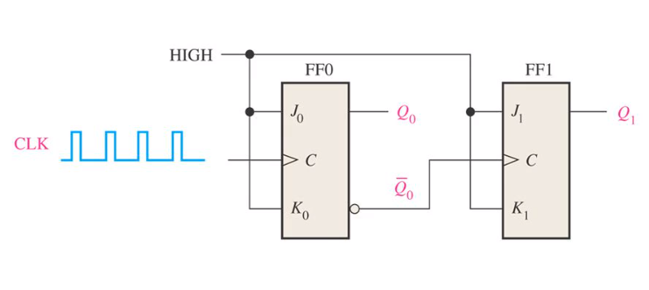
2-Bit Asynchronous Binary Counter
Clock Pulse | Q1 | Q0
Initially | 0 | 0
1 | 0 | 1
2 | 1 | 0
3 | 1 | 1
4 (recycles) | 0 | 0

Slide 6
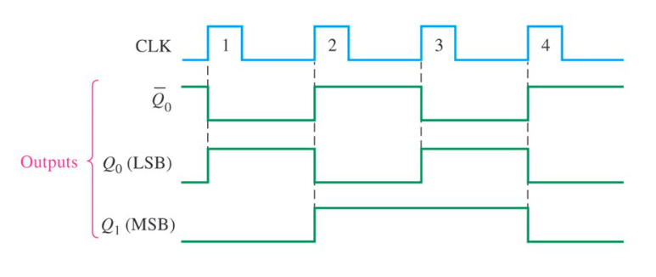

Timing Diagram
The positive edge of clock pulse 1 causes the Q_{O} output of FF0 to go High as shown in Figure. At the same time $\overline{\text{Q}\text{O}}$ output goes low, but it has no effect on FF1 because a positive going transition must occur to trigger the flipflop. After the leading edge of CLK 1, Q_{O} =1 and Q₁=0.
The positive edge of CLK-2 causes Q_{O} to go low. Output $\overline{{ Q}_{1}}$ goes high and triggers FF1, causing ${ Q}_{1}$ to go high. After the leading edge of CLK 2, Q_{O} =0 and Q₁=1
The positive edge of CLK-3 causes Q_{O} to go high again. Q_{O} =01and Q₁=1.
The positive edge of CLK-4 causes Q_{O} =0, while $\overline{\text{Q}\text{O}}$ =1 and triggers FF1, causing ${ Q}_{1}=0$.
After the leading edge of CLK-4, Q_{O} =0 and Q₁=0. The counter has now recycled to its original state ( Bothe flipflops are RESET).

Slide 7
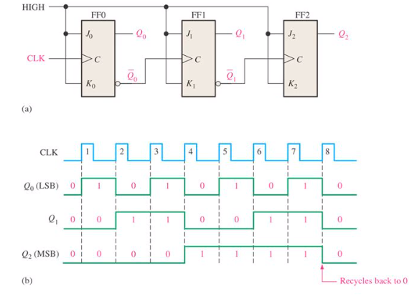
3-Bit Asynchronous Binary Counter

Slide 8
Clock Pulse | Q2 | Q1 | Q0
Initially | 0 | 0 | 0
1 | 0 | 0 | 1
2 | 0 | 1 | 0
3 | 0 | 1 | 1
4 | 1 | 0 | 0
5 | 1 | 0 | 1
6 | 1 | 1 | 0
7 | 1 | 1 | 1
8 (recycles) | 0 | 0 | 0

Slide 9
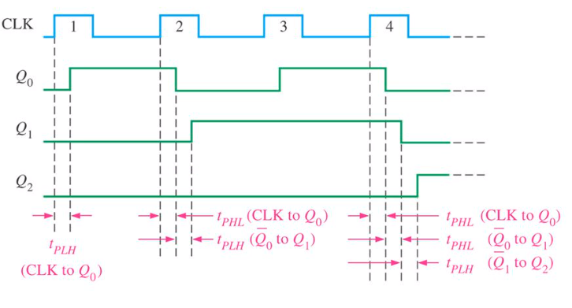
Propagation Delay
Asynchronous counters are commonly referred to as a ripple counters for the following reason: the effect of the input clock pulse is first “felt’’ by FF0. this effect cannot get to FF1 immediately because of the propagation delay through FF0. Then there is the propagation delay through FF1 before FF2 can be triggered.
Thus, the effect of an input pulse “ripples” through the counter, taking some time, due to propagation delays, to reach the last flipflop.

Slide 10
Synchronous Counters
The term synchronous refers to events that have a fixed time relationship with each other. A synchronous counter is one in which all the flipflops in the counter are clocked at the same time by a common clock pulse.

Slide 11
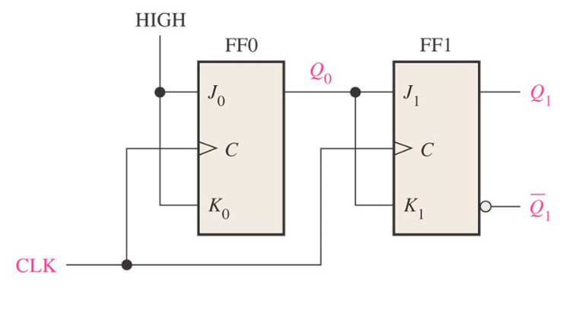
2-Bit Synchronous Counter
Clock Pulse | Q1 | Q0
Initially | 0 | 0
1 | 0 | 1
2 | 1 | 0
3 | 1 | 1
4 (recycles) | 0 | 0

Slide 12
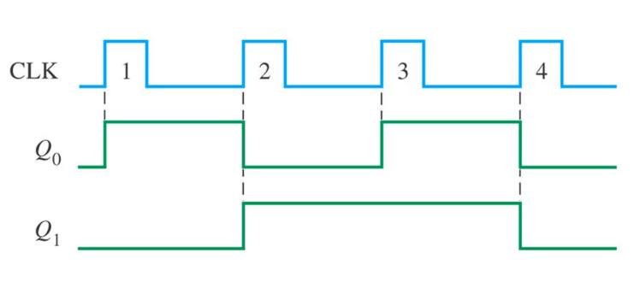
Timing Diagram
Initially let both the FFs be in the reset state means FFO and FF1 are 0.
After positive clock edge, FF0 will toggle and Q₀ will change from 0 to 1.
But at the instant of application of positive clock edge, Q₀ , J₁ = K1 = 0. Hence FF-B will not change its state. So Q_{B} will remain 0.
Q_{B}Q_{A} = 01 after the first clock pulse.
On the arrival of second positive clock edge, FF-A toggles again and Q_{A} changes from 1 to 0.But at this instant Q_{A} was 1. So J_{B} = K_{B}= 1 and FF-B will toggle. Hence Q_{B} changes from 0 to 1.
Q_{B}Q_{A} = 10 after the second clock pulse.

Slide 13
On application of the third positive clock edge, FF-0 will toggle from 0 to 1 but there is no change of state for FF-1.
Q₁Q₀ = 11 after the third clock pulse.
On application of the next clock pulse, Q₁ will change from 1 to 0 as Q₂ will also change from 1 to 0.
Q₁Q₀ = 00 after the fourth clock pulse.

Slide 14
Design of synchronous counters
Procedure of designing Synchrnous counters:
Step 1: Describe a general sequential circuit in terms of its basic parts and its inputs and outputs.
Step 2: develop a state diagram for a given sequence.
Step 3: Develop a next state table for specified counter sequence
Step 4: Create a flip-flop transition table.
Step 5: use the Karnaugh map method to derive the logic requirements for a synchronous counter.
Step 6: Implement a counter to produce a specified sequence of states.

Slide 15
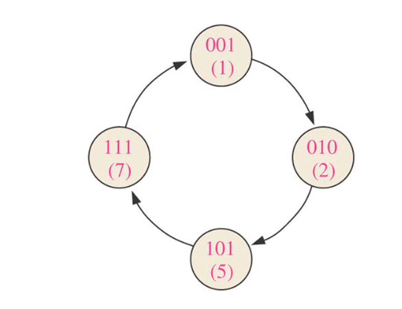
Example: Design synchronous counter with sequence 1-2-5-7.
Step 2: State Diagram
Step 3: Next state diagram
Present State Next State
Q2 | Q1 | Q0 | Q2 | Q1 | Q0
0 | 0 | 1 | 0 | 1 | 0
0 | 1 | 0 | 1 | 0 | 1
1 | 0 | 1 | 1 | 1 | 1
1 | 1 | 1 | 0 | 0 | 1

Slide 16
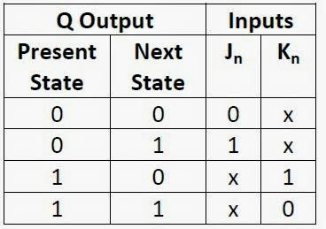
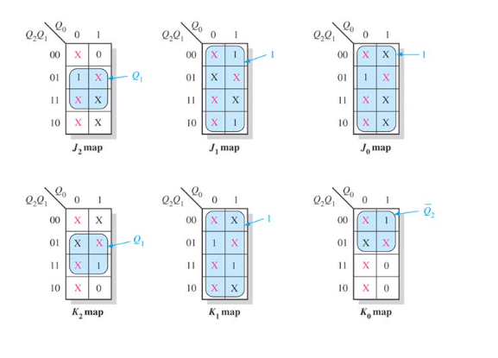
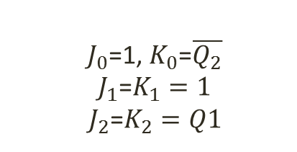
Step 4:
Step 5:
$J_{0}$=1, $K_{0}$=$\overline{Q_{2}}$
$J_{1}$=$K_{1}=1$
$J_{2}$=$K_{2}=Q1$

Slide 17
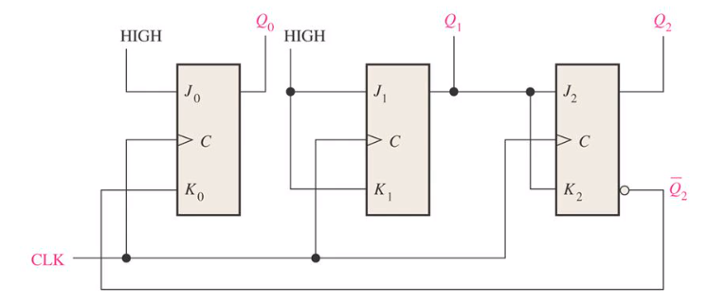
Step 6: Implementation of counter.

Slide 18
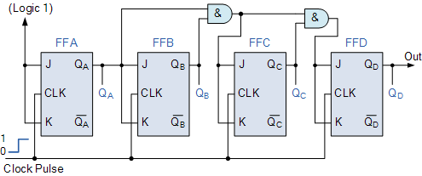
4 BIT SYNCHRONOUS UP COUNTER
It can be seen above, that the external clock pulses (pulses to be counted) are fed directly to each of the J-K flip-flops in the counter chain and that both the J and K inputs are all tied together in toggle mode, but only in the first flip-flop, flip-flop FFA (LSB) are they connected HIGH, logic “1” allowing the flip-flop to toggle on every clock pulse. Then the synchronous counter follows a predetermined sequence of states in response to the common clock signal, advancing one state for each pulse.
The J and K inputs of flip-flop FFB are connected directly to the output Q_{A} of flip-flop FFA, but the J and K inputs of flip-flops FFC and FFD are driven from separate AND gates which are also supplied with signals from the input and output of the previous stage. These additional AND gates generate the required logic for the JK inputs of the next stage.

Slide 19
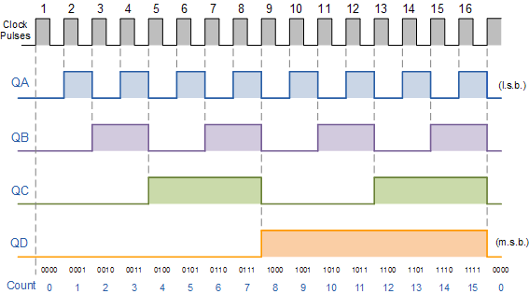

Slide 20
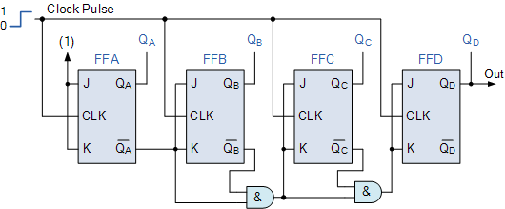
4-Bit Synchronous Down Counter
However, we can easily construct a 4-bit Synchronous Down Counter by connecting the AND gates to the Q output of the flip-flops as shown to produce a waveform timing diagram the reverse of the above. Here the counter starts with all of its outputs HIGH ( 1111 ) and it counts down on the application of each clock pulse to zero, ( 0000 ) before repeating again.

